Slide 1

Welcome!

Slide 2
How to Add or Remove an Administrator on
Your Auxiliary or Department
Facebook Page

Slide 3
Note: It is vital to have two people in your Auxiliary be an Administrator of the Auxiliary Facebook page.
Please note: Two people should have FULL ADMIN RIGHTS, not one as an Admin, and the other as an Editor or Moderator. Two people should have FULL ADMIN RIGHTS.
Why? Because an Editor or Moderator doesn’t have full access to the Facebook page. In the instances of discontinued membership, injury or death, if there is only one Admin and this occurs to them, no one else can add another member as an Admin and the Auxiliary page is essentially null and void.
(This happened to a Department page and they had to start a new page, losing all their Department fans and history. Don’t let this happen to your Auxiliary!)

Slide 4
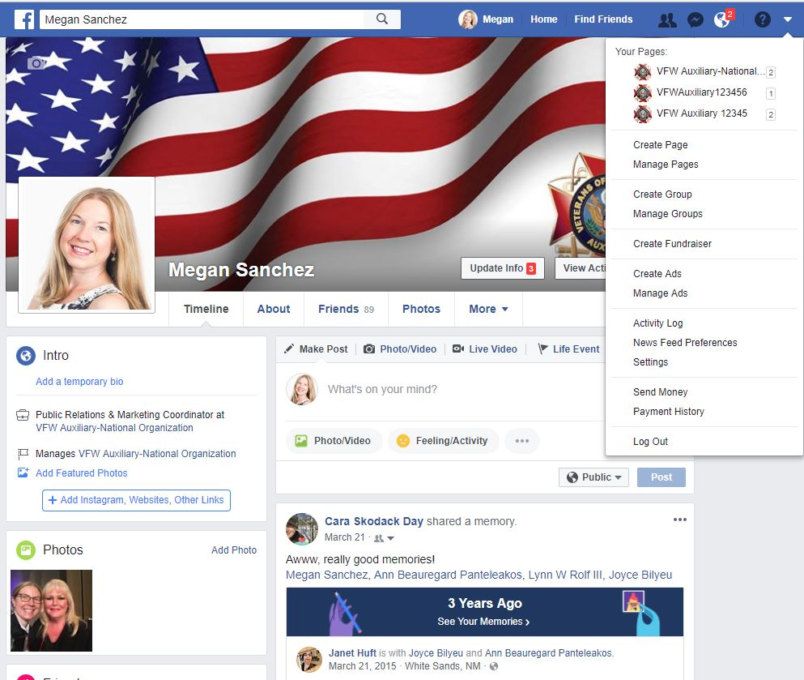
To post as your Auxiliary, go to your Personal Profile Page and select the UPSIDE DOWN TRIANGLE at the top of the page.
A drop down menu will display.
Under “Your Pages,” select
your Auxiliary.
(i.e. VFW Auxiliary 12345)

Slide 5
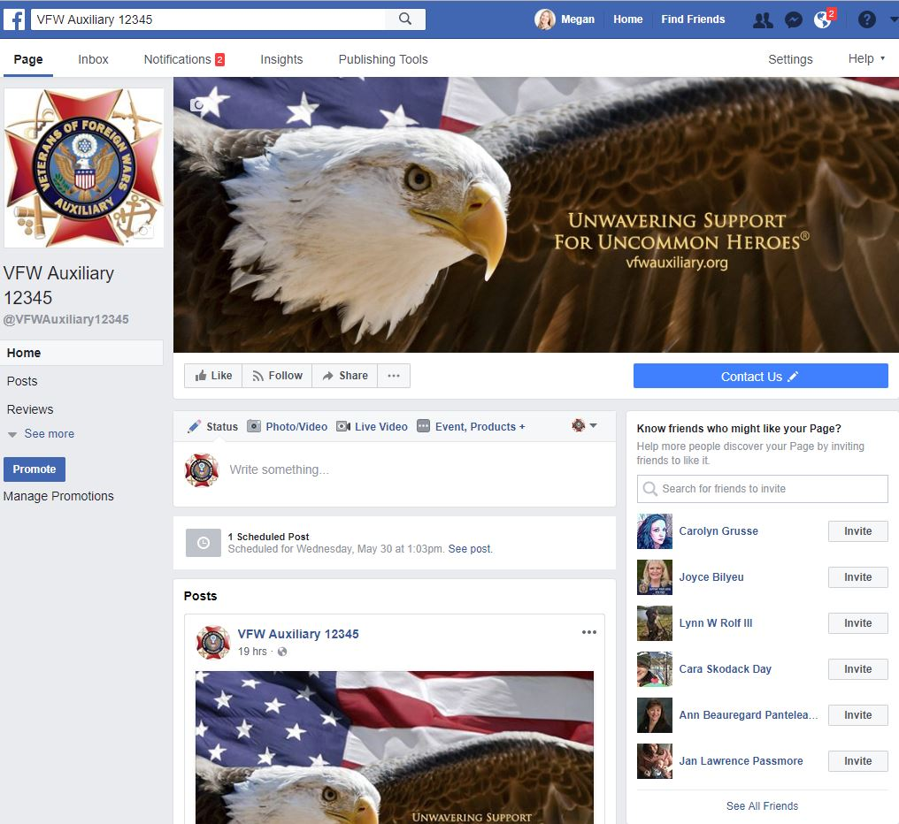
Once you’ve switched to use Facebook as your Auxiliary,
your Auxiliary page will display.

Slide 6
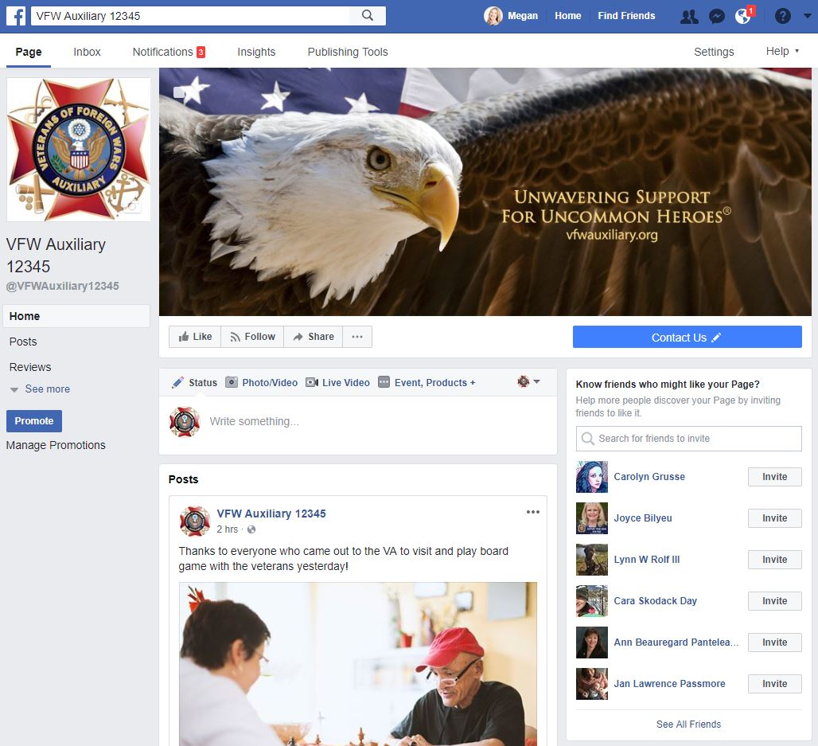
To add an Admin, go to the upper right corner top of your Auxiliary’s Facebook page.
Click “Settings.”

Slide 7
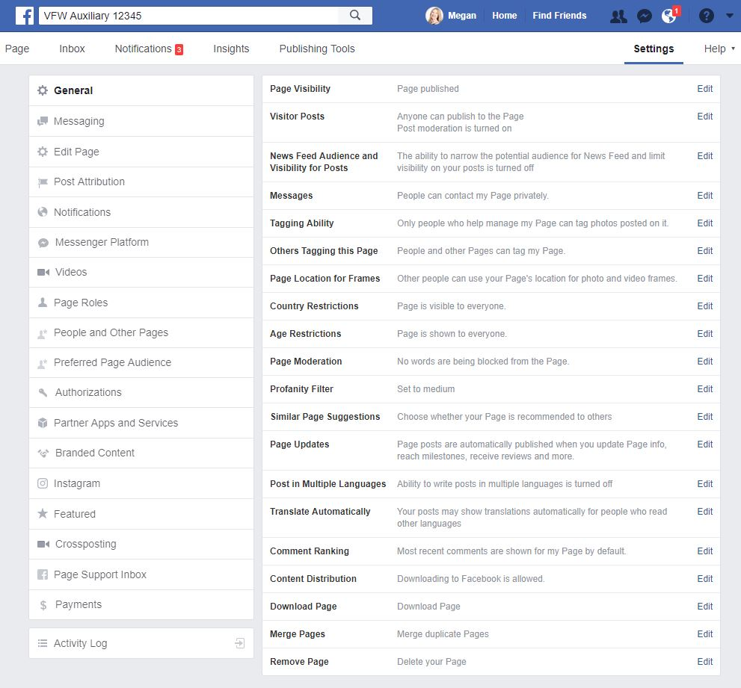
Click “Page Roles.”

Slide 8
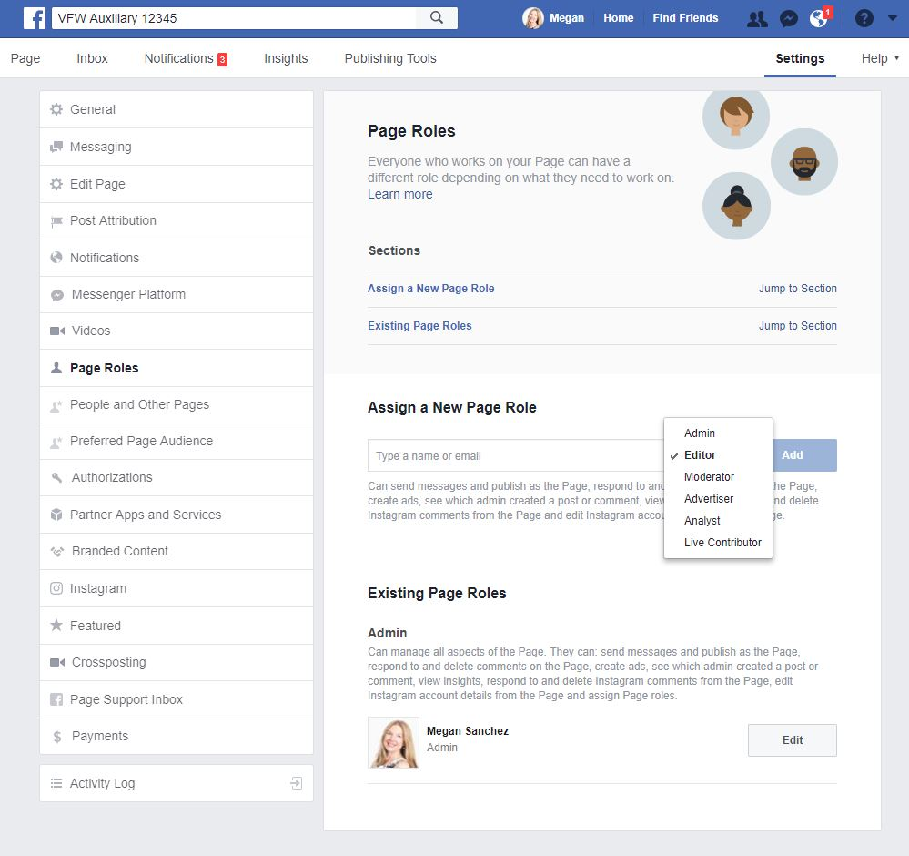
Enter the name or email address of at least one other person in your Auxiliary that you would like to make an Admin.
Note: If you are friends with the person on Facebook, their profile will populate as you type their name. If you are not, the email address entered must be the email address they use to sign into Facebook.
Select “Admin” from the
drop-down menu.
Click “Save.”

Slide 9
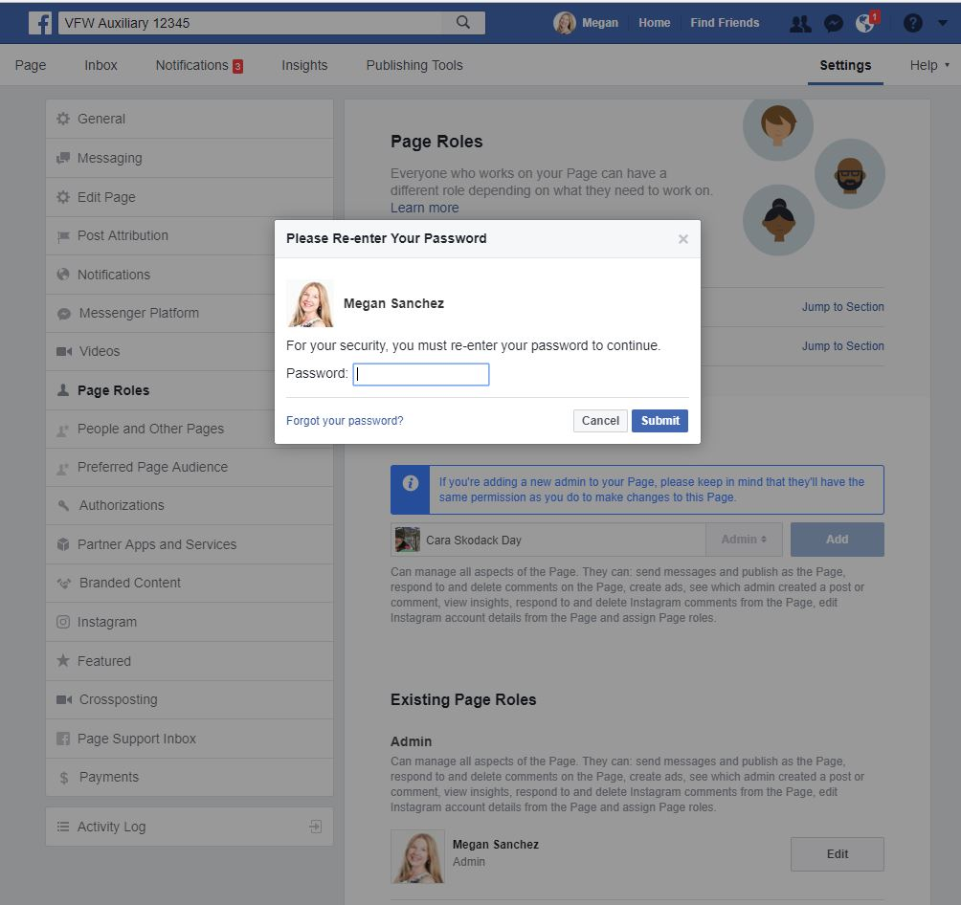
A pop-up box will display asking you to re-enter your password to continue.
You will need to enter your PERSONAL PASSWORD that
you use to log in to Facebook.
Once entered, click “Submit.”

Slide 10
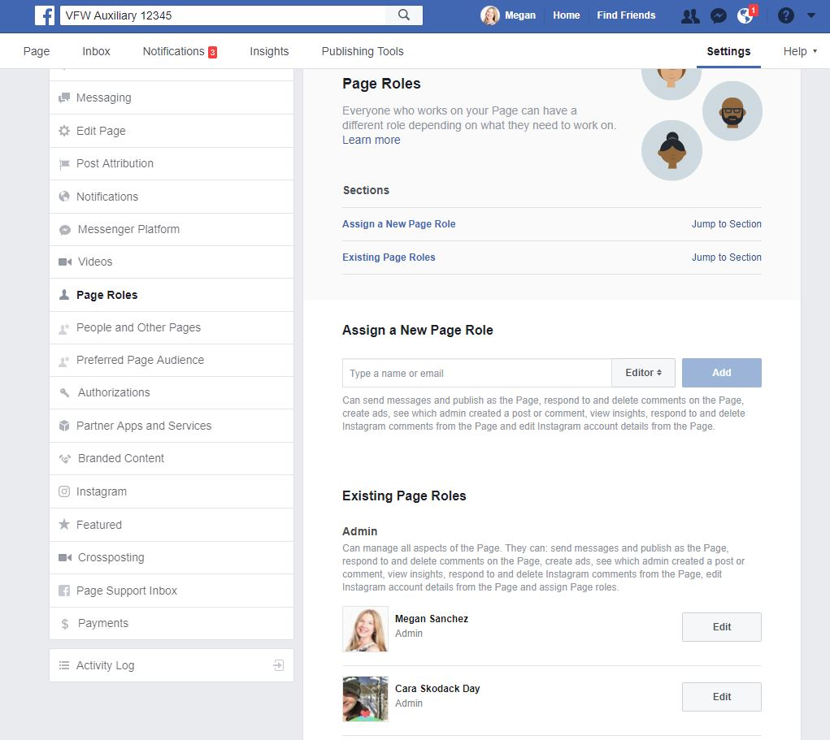
The new Admin’s profile picture will display.
You have successfully added an Admin to your Auxiliary Facebook page!
To get back to your Auxiliary’s page, click “Page.”

Slide 11
To remove an Admin, go to the upper right corner top of your Auxiliary’s Facebook page.
Click “Settings.”

Slide 12
Click “Page Roles.”

Slide 13
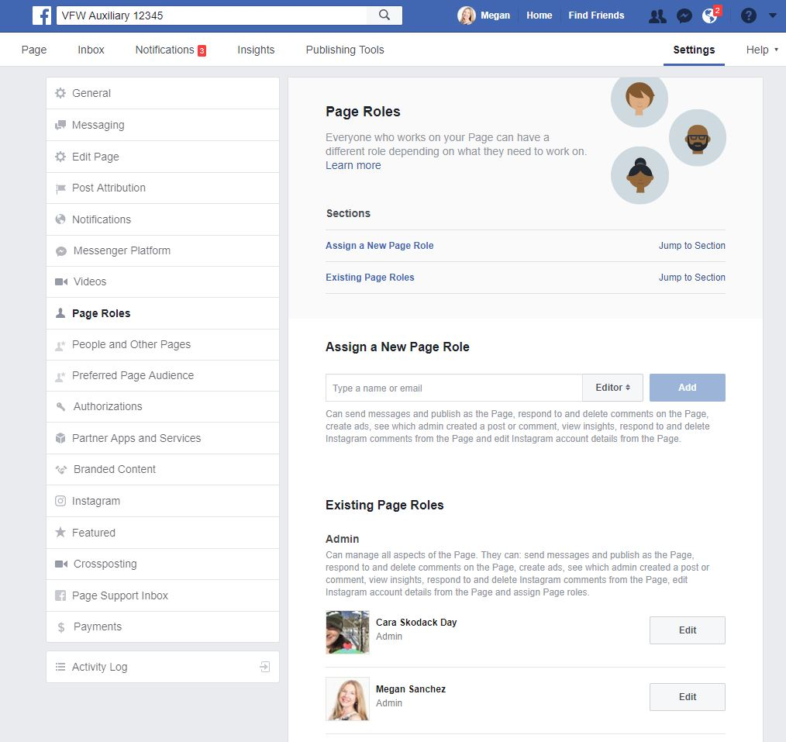
This screen similar to this will be displayed.
Find the Admin you want to remove and click the “Edit” button to the right of their name.

Slide 14
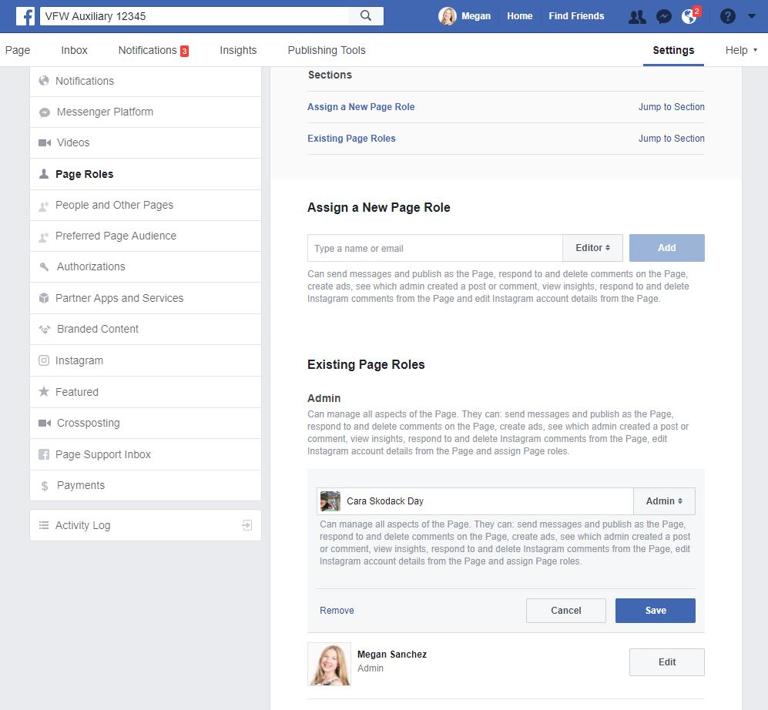
This screen similar to this will be displayed.
Click “Remove” and then the “Save” button to the right of their name.

Slide 15
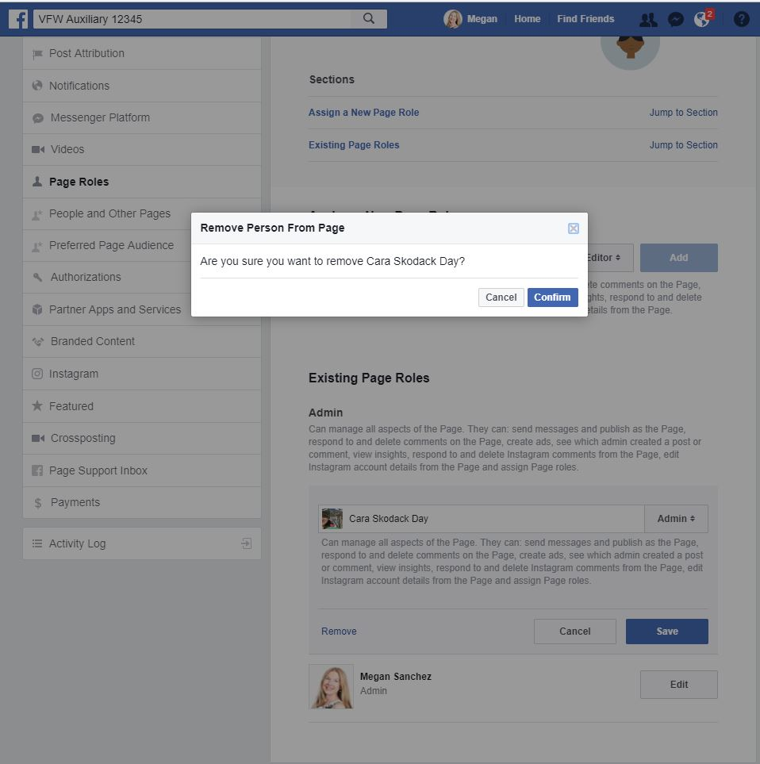
This screen similar to this will be displayed.
A pop-up will ask if you are sure you want to remove the person. Select “Cancel” to keep them as an Admin or “Confirm” to remove them as an Admin.

Slide 16
A pop-up box will display asking you to re-enter your password to continue.
You will need to enter your PERSONAL PASSWORD that
you use to log in to Facebook.
Once entered, click “Submit.”

Slide 17
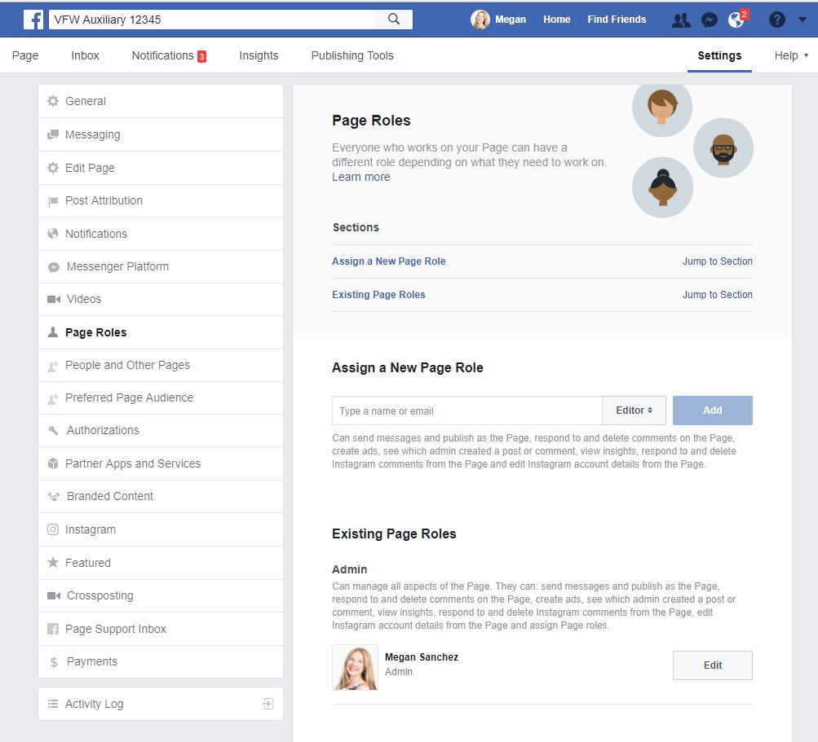
The former Admin’s profile picture will disappear.
You have successfully removed an Admin from your Auxiliary Facebook page!
To get back to your Auxiliary’s page, click “Page.”

Slide 18
Questions?
Contact Megan Zinn-Sanchez
Public Relations & Marketing Coordinator
VFW Auxiliary National Headquarters
mzinn-sanchez@vfwauxiliary.org

