Slide 1

Welcome!

Slide 2
How to Post on Your
Auxiliary Facebook Page

Slide 3
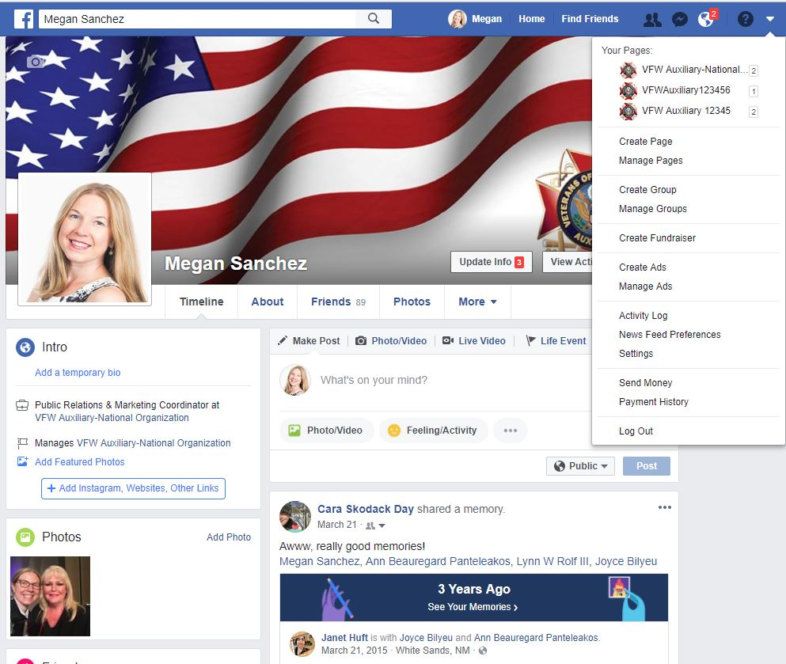
To post as your Auxiliary, go to your Personal Profile Page and select the UPSIDE DOWN TRIANGLE at the top of the page.
A drop down menu will display.
Under “Your Pages,” select
your Auxiliary.
(i.e. VFW Auxiliary 12345)

Slide 4
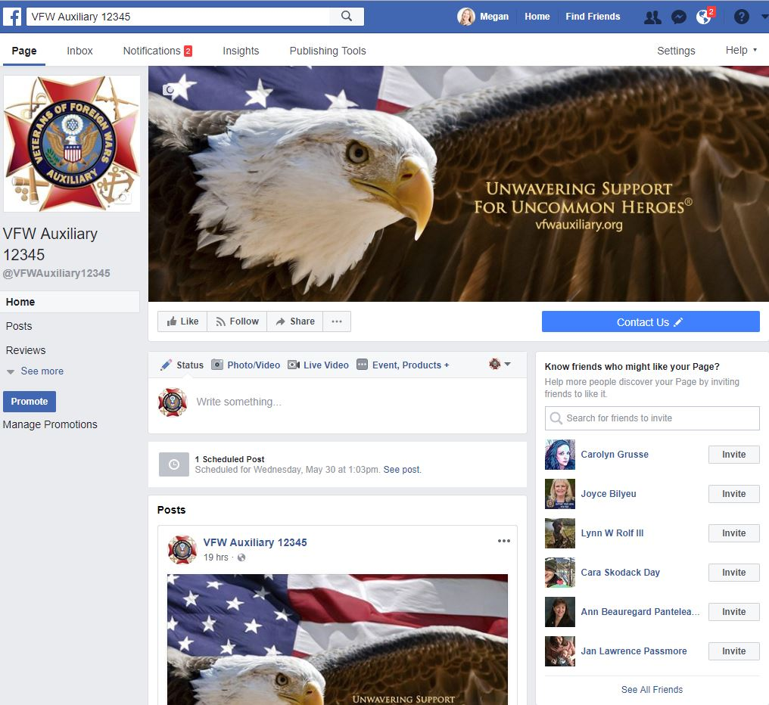
Once you’ve switched to use Facebook as your Auxiliary,
your Auxiliary page will display.

Slide 5
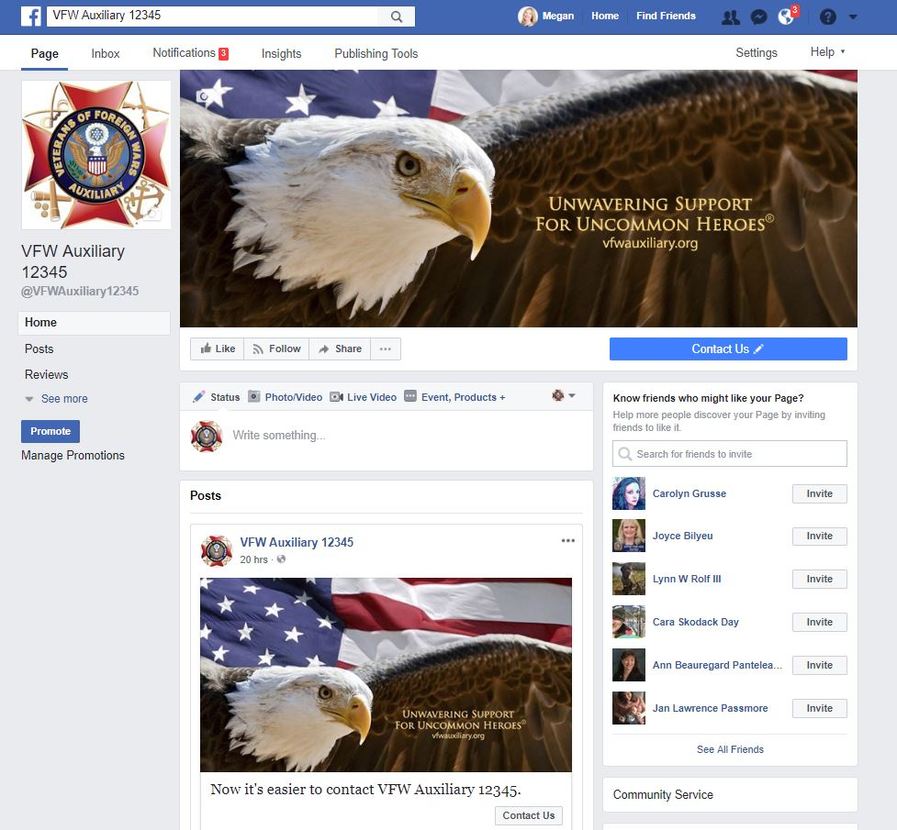
Now you’re ready to post to your Auxiliary page!
Click in the box where it says “Write something…” to type the post.

Slide 6
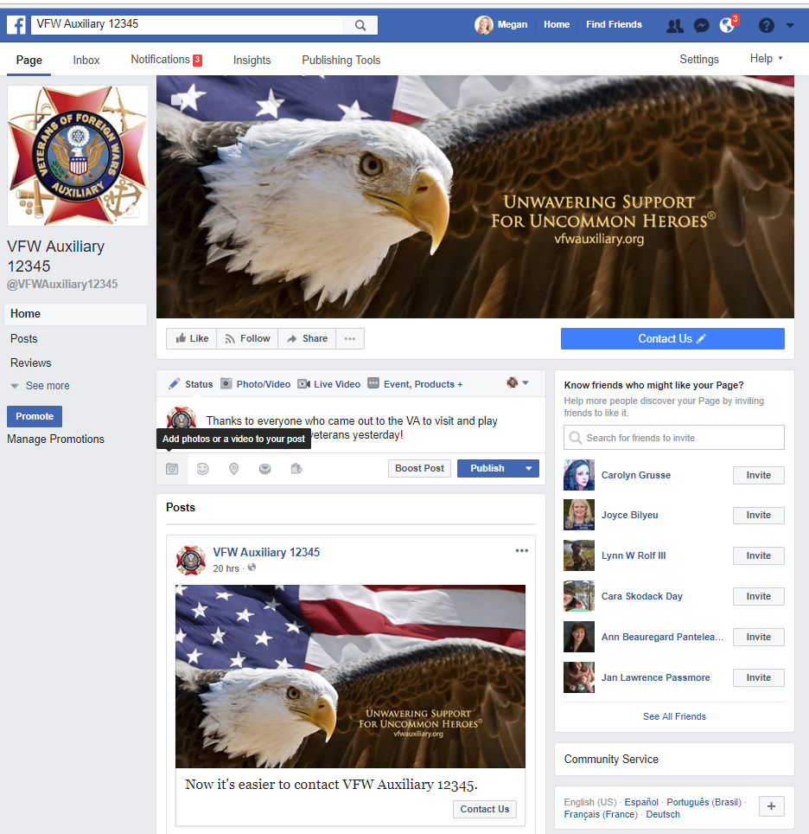
Type the post and select the Camera Icon to add a single photo or video to the post.
To create a photo album, photo carousel, slideshow and more, select the Camera Icon with the words Photo/Video next to the icon at the top of the status update box.

Slide 7

Once the photo(s) or video(s) has uploaded, a screen similar to this will display.
You are ready to publish the post!
Select the “Publish” button to publish the post immediately!

Slide 8
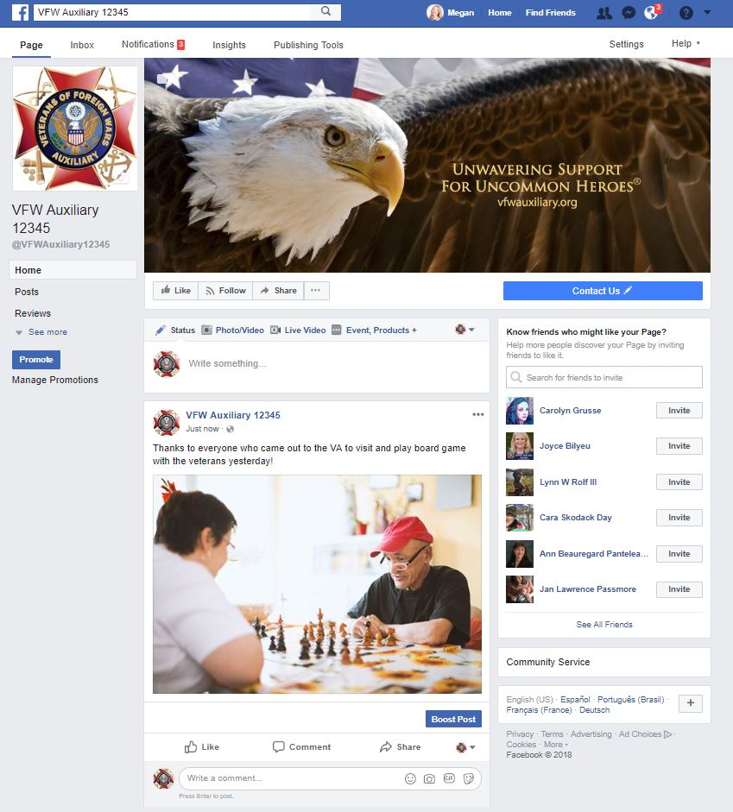
The post and photo(s) or video(s) will appear on your Auxiliary page.

Slide 9
Questions?
Contact Megan Zinn-Sanchez
Public Relations & Marketing Coordinator
VFW Auxiliary National Headquarters
mzinn-sanchez@vfwauxiliary.org

